Slide 1
Feature Engineering ,
ML Modelling &
Model Evaluation
Yogesh Padmanaban

Slide 2
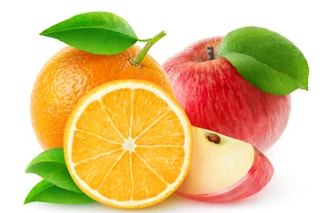
How to differentiate an Apple vs an Orange?
Available data/features :
Colour of the stem.(categorical)
Colour of the leaf.(categorical)
Colour of the root.(categorical)
Cost of the fruit.(float)
Weight of a fruit.(float)
Area of the Farm/orchid where the fruits are grown.(float)
Amount of money spent of the farm/orchid.(float)
Number of people picking up the fruit/working in the farm.(int)
Number of farms in the city.(int)
Notes:
Clearly these are not useful features for the classification. This is how data looks at first iteration of data collection.

Slide 3
How to differentiate an Apple vs an Orange?
Amount of fructose in the fruit.(float)
Vitamins present in fruits
The amount of each vitamin in the fruit.(one hot encoding)
Colour of the Fruit. (categorical)
Shape of a leaf.(categorical)
Type of the fruit(citrus vs non-citrus)
Thickness of the skin covering on the fruit.(float)
Texture of the skin (bumpy vs smooth)(categorical)

Slide 4
Which Data to pick up? The right data
ML is more about the system under study and the problem statement than a collection of Mathematical Algorithms.
understanding the flow of activity in the system gives the insight to collect the right data for the given use-case.
Data collection => data => Model => prediction
The better the Data collect, the better the data.
The better the data, the better the model.
The better the model, the better the prediction.
Notes:
Better the understanding of the system under study, the better the understanding of what useful data can be generated out of it with respect to the problem statement.
Data collection

Slide 5
Representation Learning and Feature Engineering
In order to classify a fruit into apple or Orange, we should go with the features which REPRESENTS the behaviour which is useful to differentiate the labels(Apple/Orange). This is called Representational learning.
Feature Engineering:
It is the art and science of coming up with useful features.
There is an Art, as to how much the features make sense to us.
There is Science as to how much it makes sense to the machine.
Feature Selection:
Choosing the right combination of features to solve the given problem. There 2^N possible combinations of features to choose for N features.
Correlation Coefficient
Mutual information
Chisquare test of independence/relatedness
Feature Importance from an ML Technique such as Random Forest.
Notes:
Right features in ….. Right predictions….
The model is as good as the data which is fed.

Slide 6
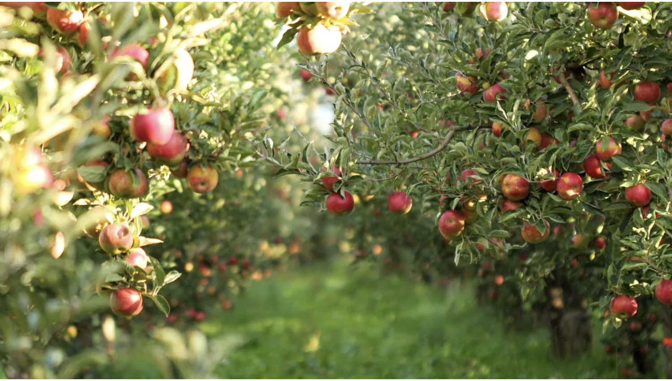
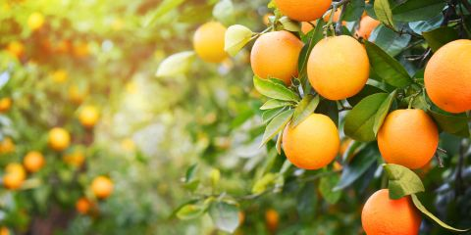
how much to Feature Engineer? Till the deadline
Available data/features :
Colour of the stem.(categorical)
Colour of the leaf.(categorical)
Colour of the root.(categorical)
Cost of the fruit.(float)
Weight of a fruit.(float)
Area of the Farm/orchid where the fruits are grown.(float)
Amount of money spent of the farm/orchid.(float)
Number of people picking up the fruit/working in the farm.(int)
Number of farms in the city.(int)
Amount of fructose in the fruit.(float)
Vitamins present in the fruit.(one hot encoding)
Colour of the Fruit. (categorical)
Shape of a leaf.(categorical)
Type of the fruit(citrus vs non-citrus)
Thickness of the skin covering on the fruit.(float)
Texture of the skin (bumpy vs smooth)(categorical)
Notes:
Collect as much as possible. Add as much as domain features as possible and as much as related features as possible.

Slide 7
How to improve the model performance
Better Data ( curated and cleaned )
Better Features ( according to Feature Engineering and Feature Selection )
Better Models ( increasing sophistication of models )

Slide 8
Learning , Patterns and ML
“ Learning is ability to repeat .“ if someone says they have learnt it . they can repeat it.
A pattern is a regularity in repetitiveness of activities / events / data points / pixels.
A pattern could be anywhere. it could be a data points at 1D or a 2D (line or a curve could match it or a 3D where a surface could match/explain it )
When the pattern occurs on images then its recognition is called computer vision.
when patterns occurs at texts, then its recognition is called as natural language processing.
A machine learns to do something when it recognizes the repetition of its activities or captures the patterns in its activities and applies the patterns on new/incoming data.
A computer is said to have learned something with Experience E , if the performance P on a task T improves with Experience E.
We are data scientists. We experiment with patterns!
Notes:
Introduction to Learning!

Slide 9
What if computers can code ?
Based on what we do with a computer what if computer looks at the patterns and starts to code on its own?
GPT-3 ( Generative Pretrained Transformer -3 )
Generating SQL
Generating CSS:

Slide 10
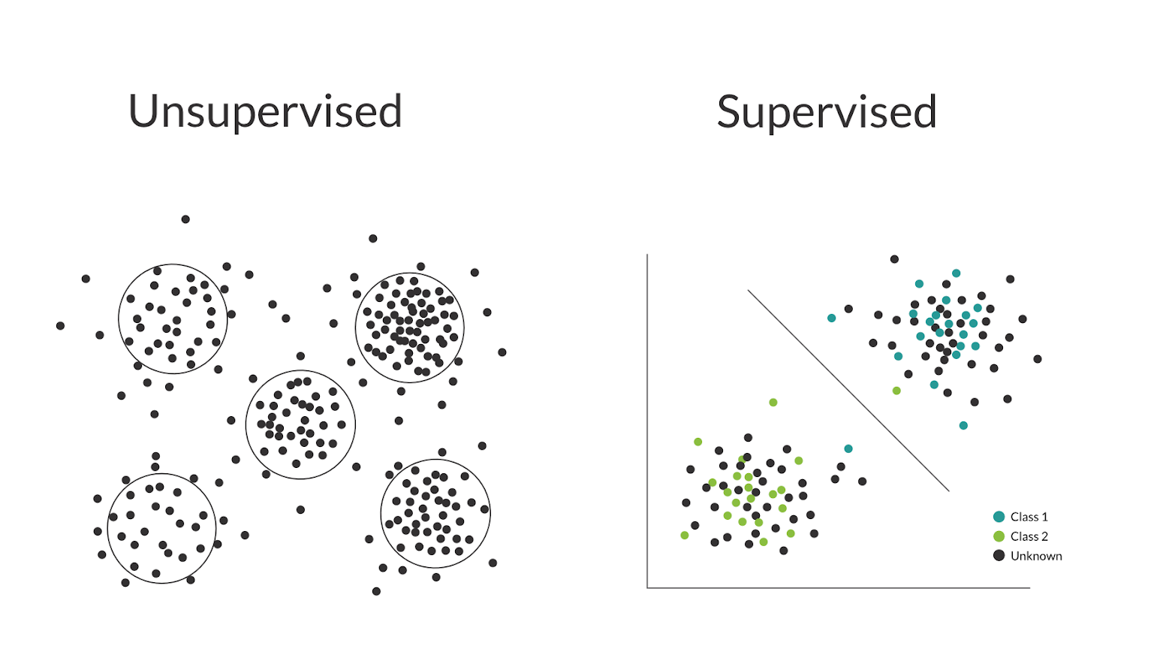
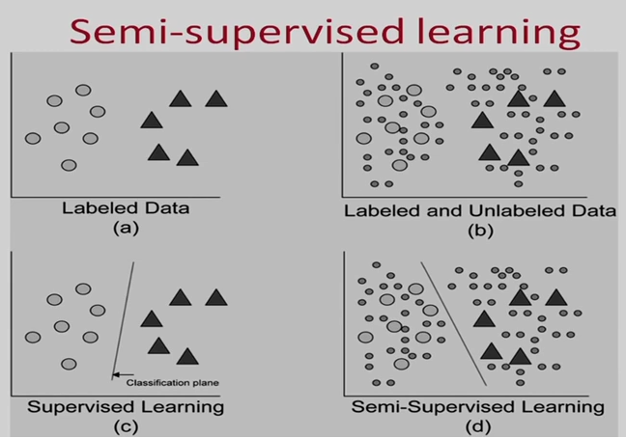
Machine Learning : A recap
Supervised Learning: Enabling a machine to learn patterns in known Dataset with respect to the target label and apply the patterns into new unseen/unknown dataset to generate Predicted target Labels by computing the probability of those labels on new data.
Unsupervised Learning: Enabling a machine to learn patterns in Data without a target label for similarity analysis.
Semi-Supervised Learning: Hybrid of above. Eg: K Nearest Neighbour technique + Classification.
Notes:
What it is and what it can do ?

Slide 11
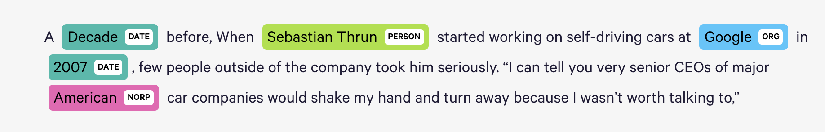
Machine Learning: Structured Output : NER
Structured Output:
Parsing: Named Entity Recognition: ( Conditional Random Fields )
demo

Slide 12
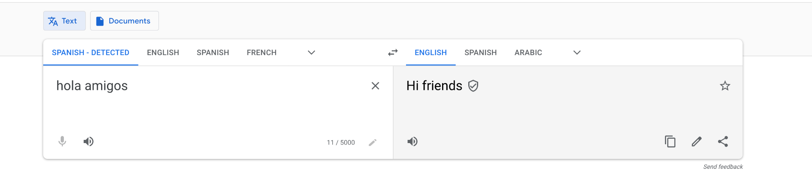
Machine Learning : Structure Output : Translation
Demo: LSTM + GRU + ATTENTION

Slide 13
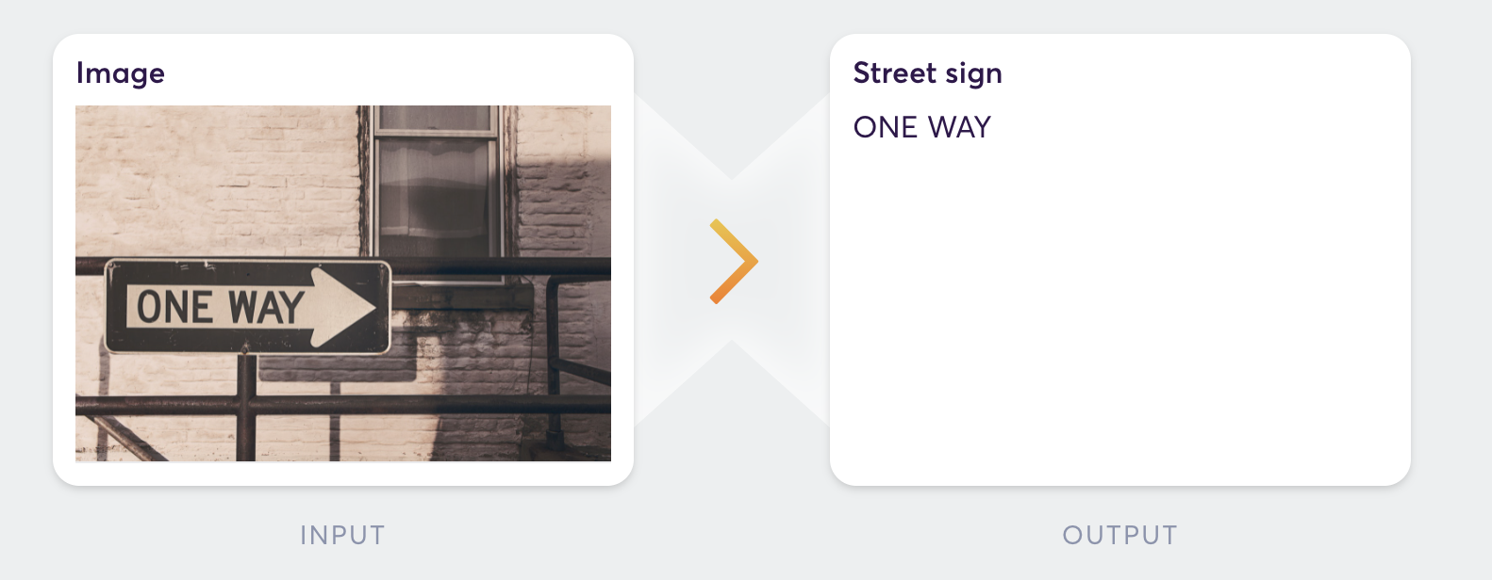
Machine Learning: Structured output: Transcription
Demo: Google Lens ( CNN + RNN )

Slide 14
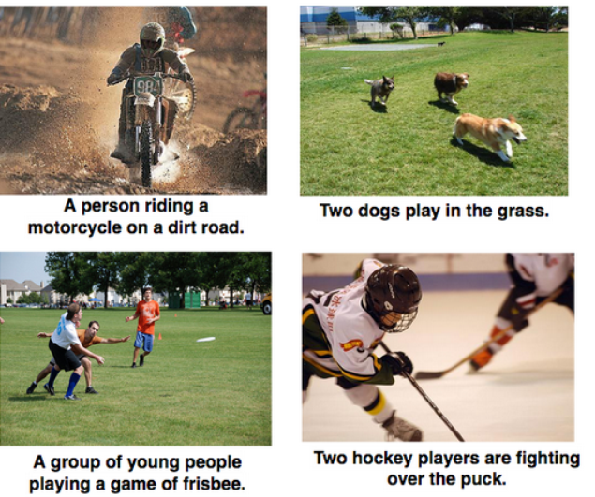
Machine Learning: Structured Output: Image captioning (CNN + RNN)
Demo:

Slide 15
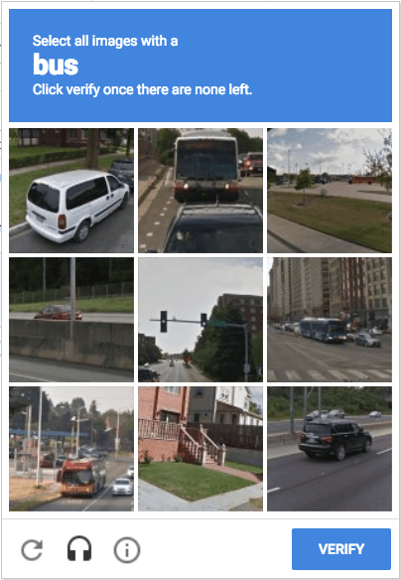
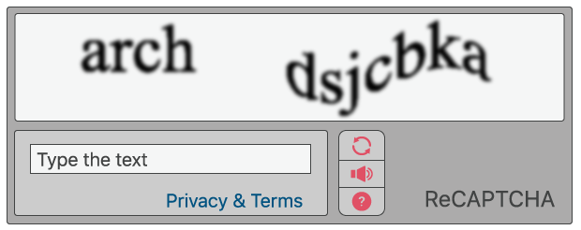
Improving Captchas vs Transcriptions

Slide 16
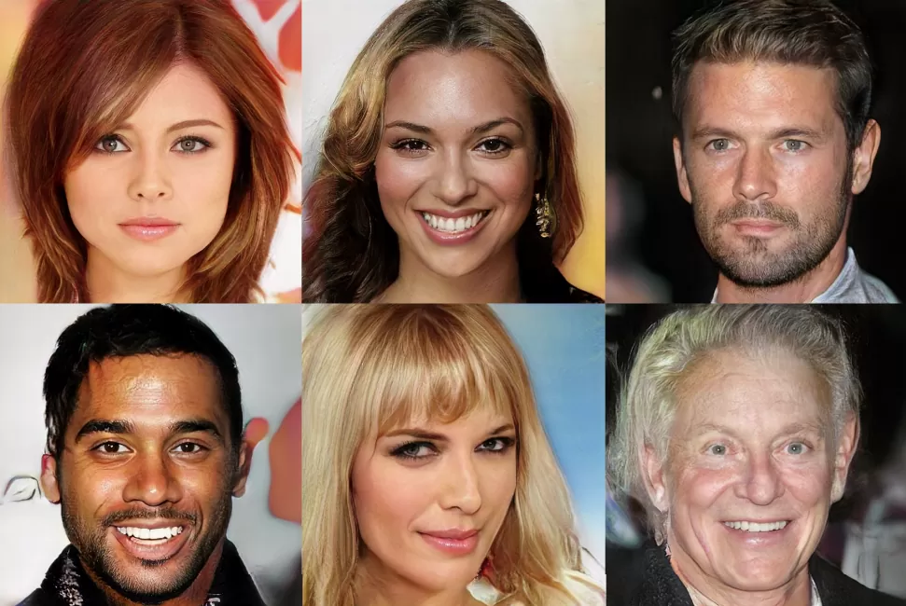
Synthesis ( Generative Adversarial Networks )
Computers can generate realistic images using Generative Adversarial Networks (GAN).
Observe the Facial symmetry
Computers can generate music. (demo)

Slide 17
What if a computer takes action upon learnings from ML?
The end product of ML is a prediction or a learning or an vector output.
It doesn’t take action upon it.
Machine Learning to Machine Doing it ?. It is called Reinforcement Learning!
An Agent
It is an autonomous entity which acts upon an environment,
It directs its activity towards achieving goals or maximizing rewards,
using observation through sensors and consequent actuators.
This is where AI begins!

Slide 18
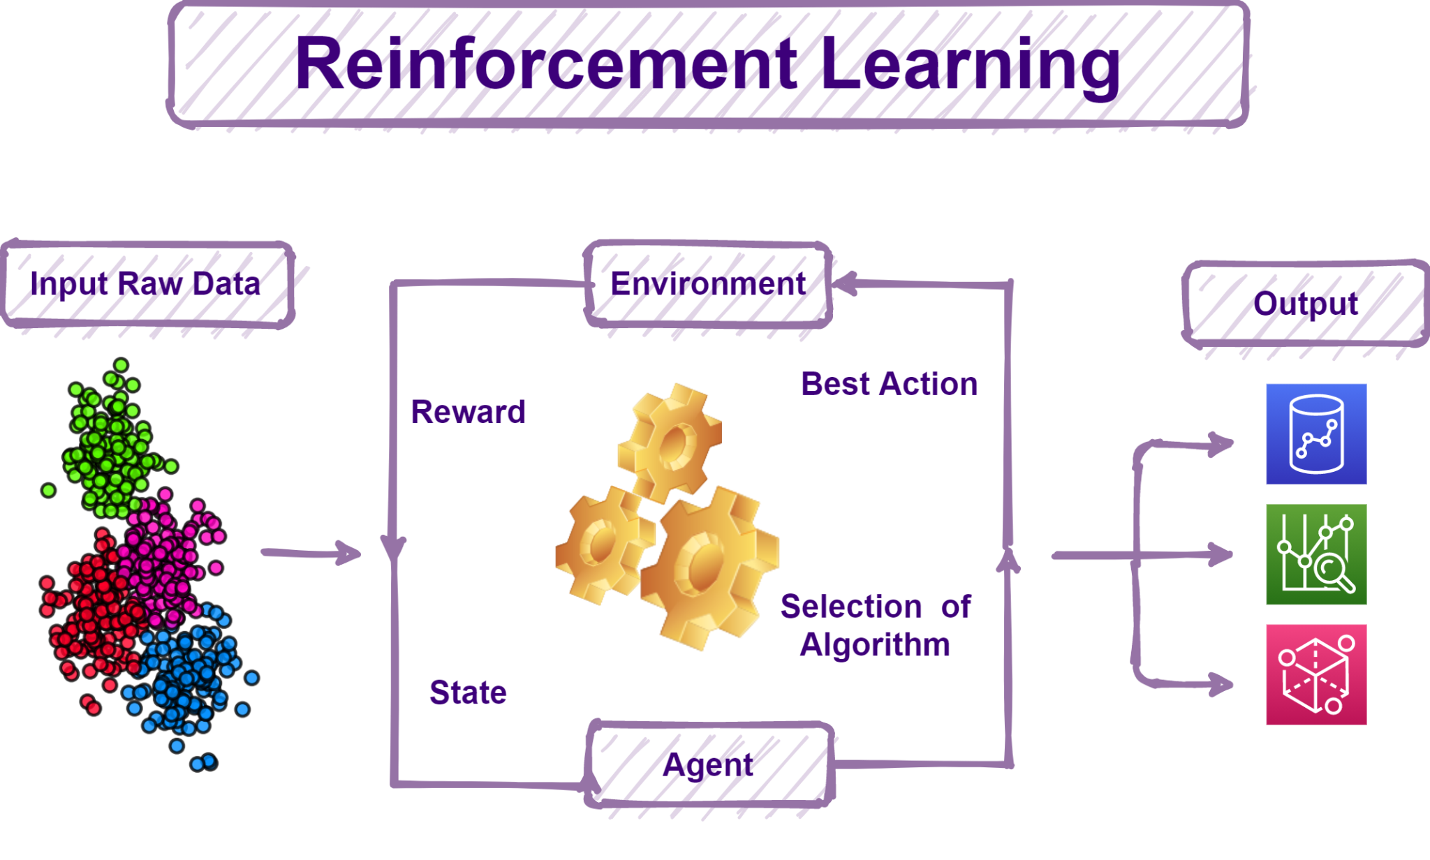
Reinforcement Learning: Computers can play games!
Demo:
Computers can drive cars!
Notes:
1.Learnings are encoded in the states and the algorithms for each states.
2.Agent tries to maximize the Reward

Slide 19

Supervised Learning: Regression and Classification
Regression: We predict where the new data will occur.
Classification: we predict which class the new data will belong to.

Slide 20

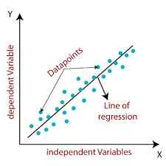
ML Algorithms - Regression
Linear Regression: Line of best fit.
Polynomial Regression: Curve of best fit.
Notes:
Line summarizing the distribution of data points.

Slide 21
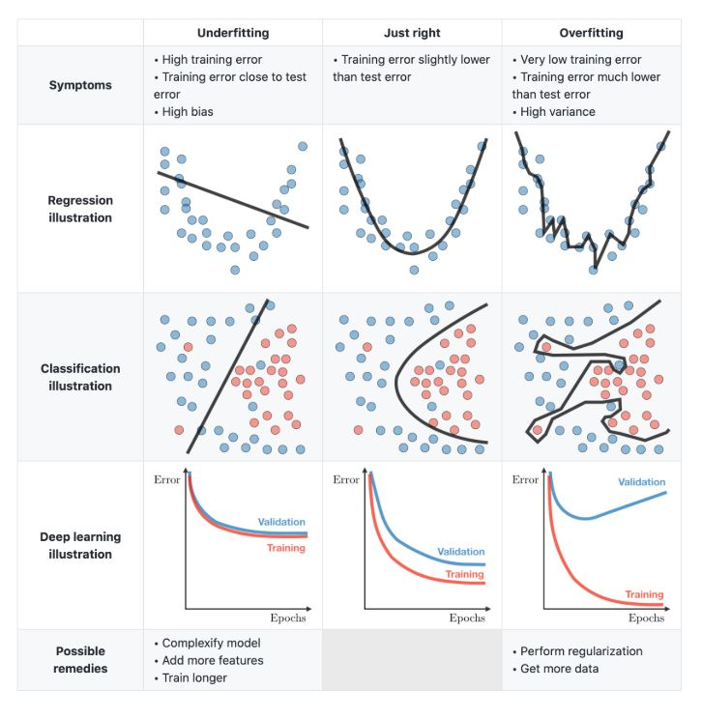
Overfitting and Underfitting
Notes:
Classification a similar story where in we have simple lines dividing nonlinearly separable points.then we go for curves which tries to divide the data points into classes. If we want to be greedy we wouldn’t be able generalize for the incoming new data.

Slide 22
Overfitting and underfitting: a student analogy
Overfitting is like a student who is mugging up the questions and answers.
Underfitting is like a student who didn’t attend enough classes.
Right fit is the student who understands the concepts(trends) and answers for new unseen questions.

Slide 23
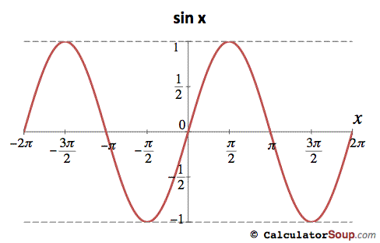
Detour: Optimisation (Maximum/Minimum)of a function f(u)
Supposing I have a function f(u)=sin(u)
How do I find the maximum value it can take?

Slide 24
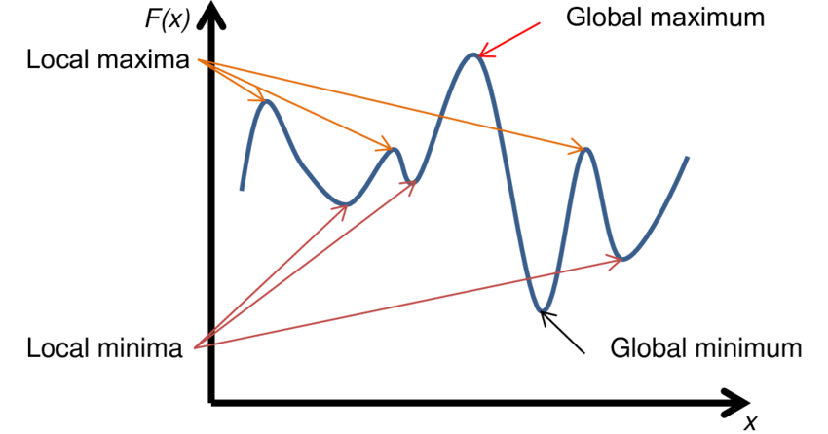
OPTIMISATION: finding the optimum value of a function
Notes:
Troughs the minimum and peaks the maximum.

Slide 25
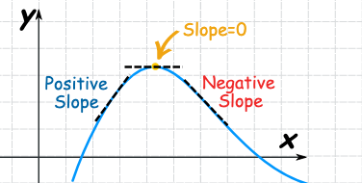
For an unknown function how do we find the optimum?
Notes:
As x increases y increases, it is a positive slope.
As x increases y doesnt increase or decrease it is the negative slope.
As x increases y decreases this is negative slope.

Slide 26
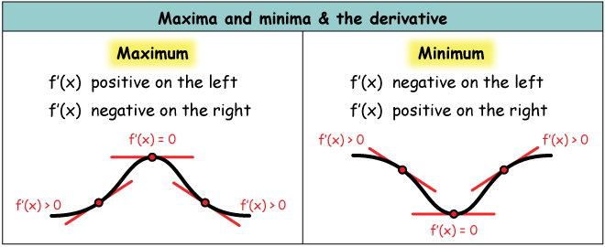
For an unknown function how do we find the optimum?
Notes:
Differentiation calculus at 10th std maths class.
Second degree derivative and find the value ot negative for maximum and positive for minimum.

Slide 27
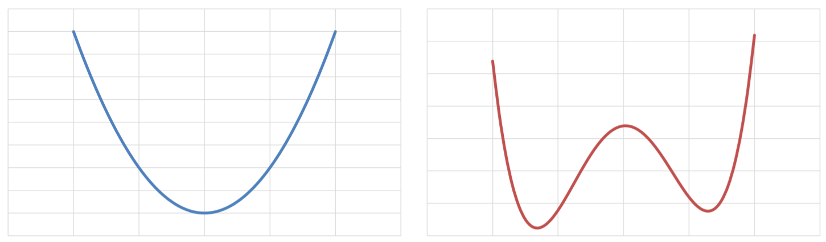
Convex and non-convex optimisation
Notes:
There is only one optimal value and Finding an optimal values is enough to find that global optimum value.

Slide 28
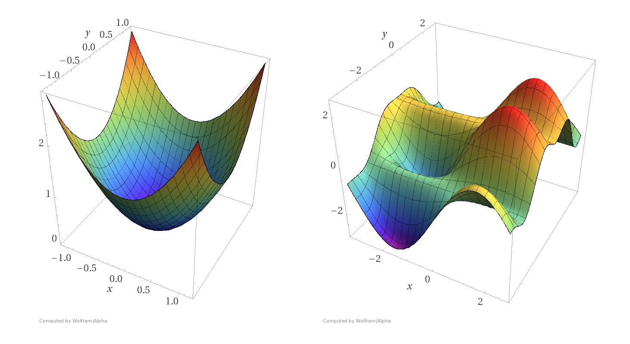
Convex and Non-convex optimisation (Multi-Dimensional)
Notes:
One optimal in the entire terrain for convex optimisation and multiple optimal values non-convex optimization.

Slide 29
Analogy: Like A careful blind guy in a mountain range.
Troughs and Peaks.
Notes:
Think like a careful blind guy who treads these mountains and troughs. He senses them and steps forward to reach the optimal value. He knows mathematics. He finds the slope of the terrain for peaks and valleys.

Slide 30
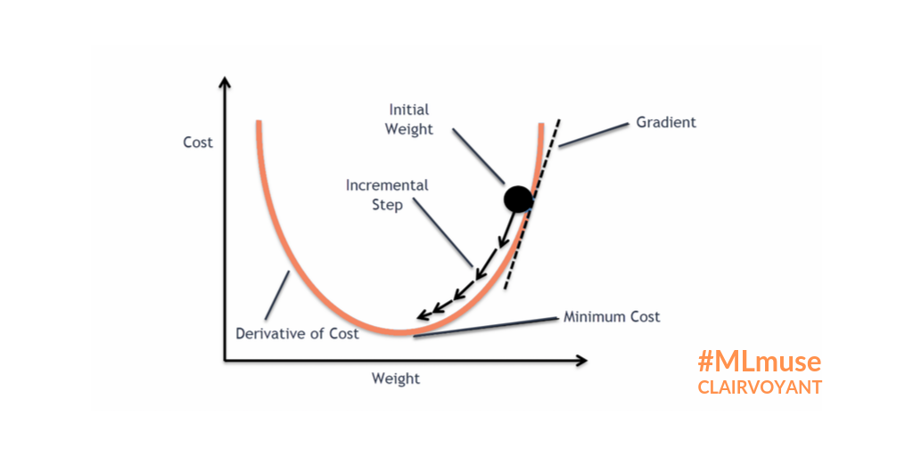
Gradient descent:
Like A careful blind guy to identify the trough

Slide 31
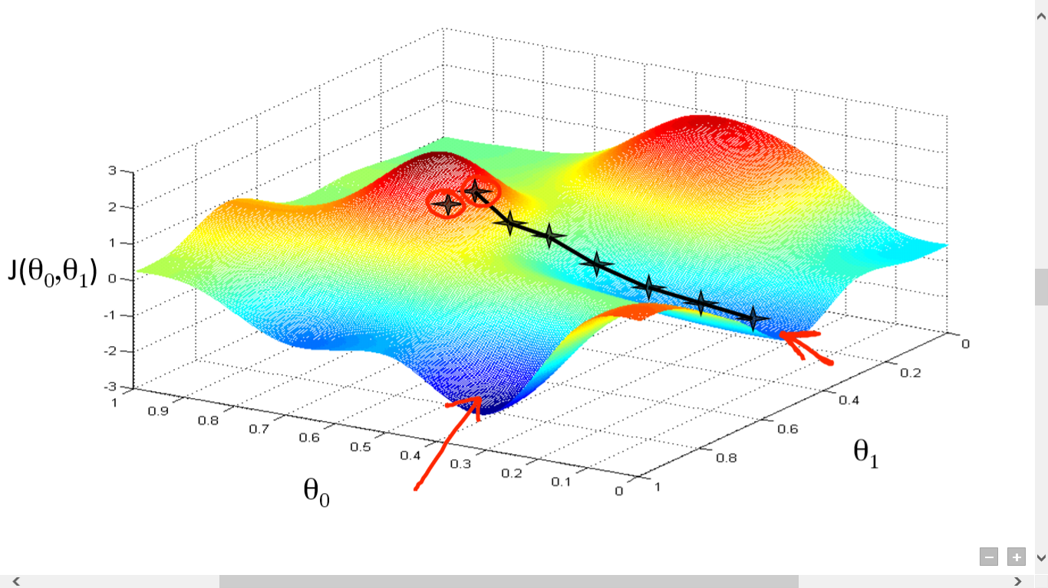
Multi dimensional Gradient Ascent
Notes:
What we did all the times were finding the regions of least errors.

Slide 32
What to Optimize in ML? errors,sum of errors,loss function
For Classification Problem: We want to MINIMIZE the Classification error.
For Regression Problems: We want to minimize the distance between the data points and the Curve .

Slide 33
Convex and non-convex optimisation on loss/error function
Many good models. But can reach to only one ! we don’t know if we have reached the best model !
Only one good model and that is the best model possible!

Slide 34
Convex optimisation on Error Function
Follow the slope of the curve till you find a “good” value.
Whatever “good” you find is gauranteed to be the best value.
The model has achieved the best performance at this spot.
Only one good model and that is the best model possible!

Slide 35
Problems with non-convex optimisation
We can reach only one “good” value.
We don’t know if it is the best value possible!
There could be many good values.
Should we search for another good value?
What is the guarantee of getting a good value BETTER than this ?
EXPLORATION vs EXPLOITATION.

Slide 36
The Blind guy can find only one good model!
Best model with least errors
Only one good model and that is the best model possible!
Many good models and can reach to only one ! we don’t know if we have reached the best model !

Slide 37
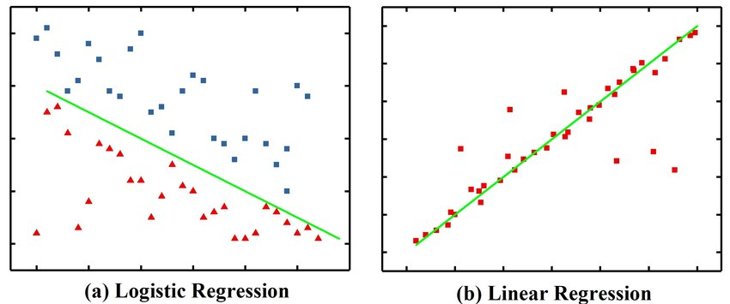
Logistic Regression, a convex optimisation algorithm

Slide 38
Linear Regression, a convex optimisation algorithm
How to Minimize the Errors in Classification / Regression? Gradient Descent!
Why is ML not a simple problem like “ FIND x “ and we can simply apply rules of Mathematics and get the solution?
This is because there are many solutions to this problem. We need to find the best solution amongst the available solutions.
There are many lines/curves which can classify the data points. There are many lines which can pass through the data points for regression.
ML is essentially a line drawing / curve fitting through the data.

Slide 39
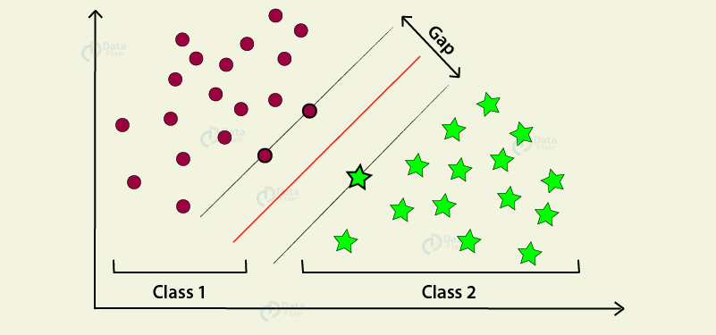
Support Vector Machines with many separators
Decision Boundary

Slide 40
Support Vector Machines, a convex optimal Algorithm

Slide 41
Decision Trees, Classification
a | b | Flag
2 | 4 | True
2 | 5 | False
a=2
b=4
b=4
b
Flag=True
a=2
4
5
a=2
b=5
b=5
Flag=True
Flag=False
Flag=False

Slide 42
Decision Trees, A Box boundary Classifier
a | b | c | Flag
2 | 4 | 8 | True
2 | 4 | 5 | False
2 | 5 | 9 | True
2 | 5 | 7 | False
b
c
4
5
c
8
5
9
7
Flag=True
Flag=False
Flag=True
Flag=True
b=4
b=4
c=8, True
a=2
b=4
c=5,False
a=2
a=2
c=9, True
a=2
b=5
b=5
b=5
c=7,False

Slide 43
Types of nodes in a decision tree
Categorical
boolean
orange
blue
False
True
green
yellow
numerical
Floats
4
8
0.1 to 0.5
5.0 to 6.0
7
9
0.5 to 2.0
2.0 to 5.0

Slide 44
Decision Trees, purity of a Node
a | b | Flag
2 | 4 | True
2 | 4 | False
2 | 4 | True
2 | 5 | False
b
4
5
Flag=True(2),False(1)
Flag=False
Impure node
pure node
The idea is to maximize the purity of a node on each division of a decision tree. The purity is measured by the following mathematical metrics:
Entropy
Information Gain
Gain ratio
Gini coefficient
Reduction in variance.
Chi square index.
a=2
b=4
a=2
b=4
Flag=True(2), False(1)
Flag=False
a=2
a=2
b=5
b=5

Slide 45
Decision Tree Inference
a | b | Probability of Flag=True | Prediction | Real Flag values
2 | 4 | 0.66 ( ⅔ ) | True ( >0.5 ) | True
2 | 5 | 0.00 | False | True

Slide 46
Is one Decision Tree Sufficient?
How many distinct decision trees with n Boolean attributes?
= number of Boolean functions
= number of distinct truth tables with 2^n rows
= 2^(2^ N) Decision Trees!
Not practical to explore them all.
But we can randomly create a bunch of decision trees; find the output of each Decision trees; and find the majority of the output; this technique is called “Random” Forest.

Slide 47
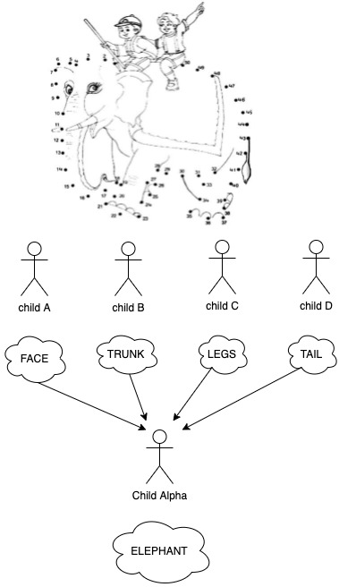
Ensembling, children finding patterns
Each child is independent to look at what they want and what they can.
They can come up with what they have found out.
They provide the individual patterns to an alpha kid who finds Meta-patterns from the given set of patterns as input from the children A-D.
Each child => Decision-tree
alpha child => a logistic regression.
This is called stacked-ensembling.

Slide 48
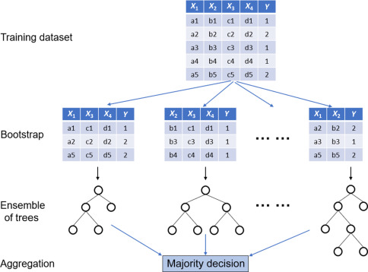
Random Forest: a forest of trees aggregated

Slide 49
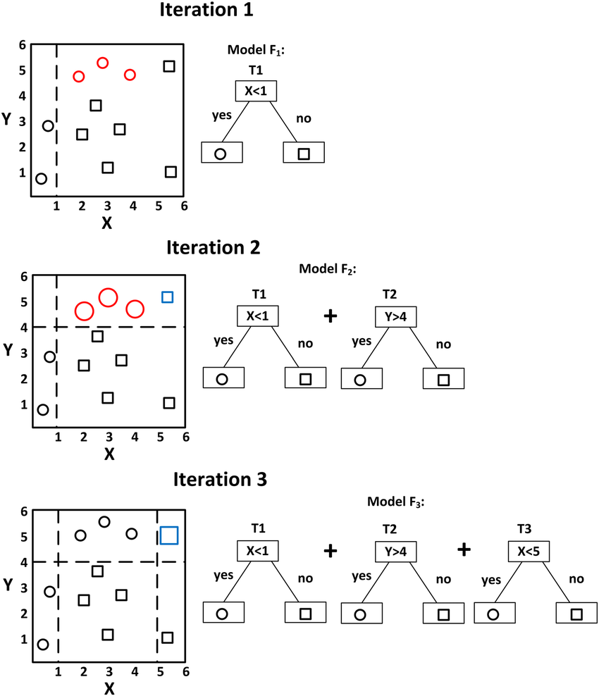
Greedy, self correcting Gradient Boosted Trees
Notes:
It keeps on adding trees to itself. It is an additive tree classifier.

Slide 50
Greedy, self correcting Boosted Trees
Notes:
Only look at the

Slide 51
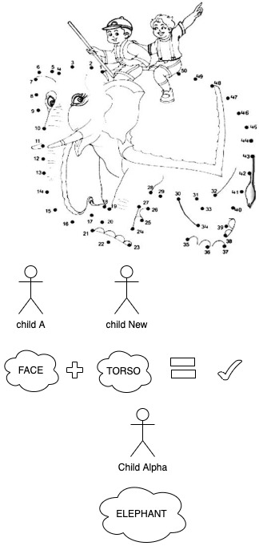
Boosted Trees: Analogy of children
finding patterns
Consider the Alpha Child who wants to improve the accuracy of his prediction.
He would accept a child’s findings if they improve the accuracy of the earlier prediction.
If not he would reject the findings of a child.

Slide 52
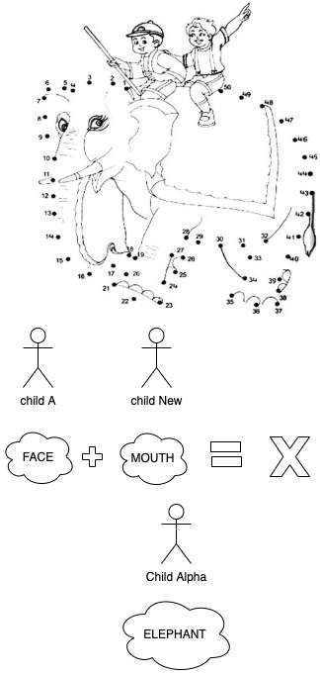
Boosted Trees: Analogy of children
finding patterns
Consider the Alpha Child who wants to improve the accuracy of his prediction.
He would accept a child’s findings if they improve the accuracy of the earlier prediction.
If not he would reject the findings of a child.

Slide 53
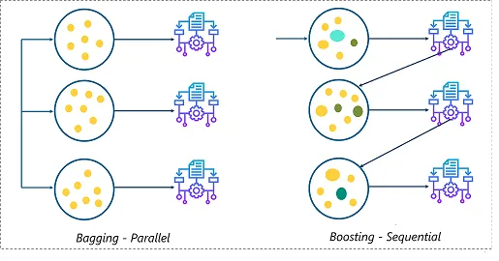
Bagging and Boosting Trees

Slide 54
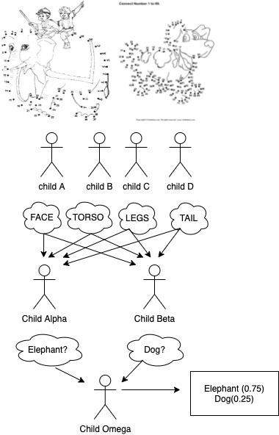
Neural Network
It is an ARMY of Kids each of them finding patterns from their input and giving their findings for the next layer till the Child Omega.
This is called forward propagation.
Forward Propagation looks like a stacked ensembling.
Then there is backward propagation

Slide 55
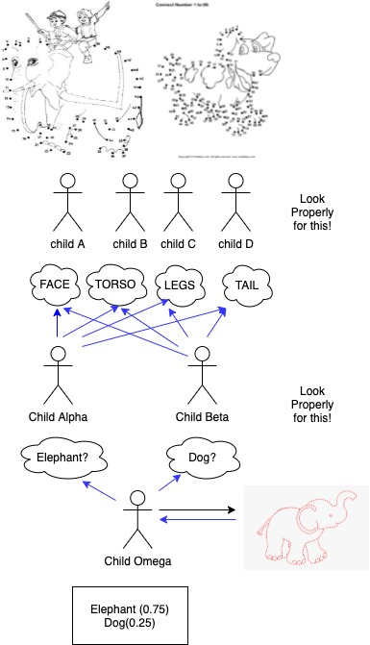
Neural Network: Backward propagation
The Omega Child looks at the final prediction and the given truth label and obtains difference. He then says “look properly for this!” to Alpha and Beta Children.
The row of Alpha and Beta children looks difference between result from Omega and their prediction/output. They modify how they look at the pic and then says “look properly for this!” to Children A,B,C,D.
The Children A,B,C,D looks at the difference between their prediction and result from Alpha and Beta child and modify how they look at the picture. (weights)
Child => logistic Regression

Slide 56
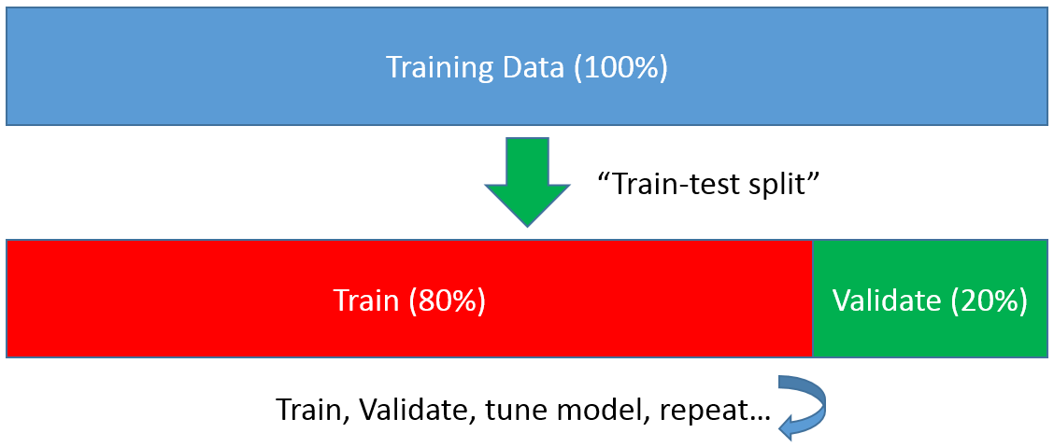
Data Split 80-20
In order to verify the efficacy of the model built, we divide the data into training and Testing dataset with a ratio of 80:20.
We train the model on 80% of the data and test the performance on the remaining 20% of the data.

Slide 57
Model Evaluation-Classification
Lets say our positives are apples. Negatives are oranges.
True Positives: Classifier predicting apples as apples.
False Negatives: Classifier predicting apples as oranges.
True Negatives:Classifier predicting oranges as oranges.
False Positives:Classifier predicting oranges as apples.
Precision: How precise is our prediction. Of all the fruits predicted to be an apple how many are actually apples.
Recall: How much of coverage of the positives is done by the classifier. Of all the actual apples how many are caught as apples by the classifier.
Let’s say we have 50 apples and 50 oranges.
Classifier predicted 45 apples as “apples”(True Positives) and 5 apples as “oranges”(False Negatives).
Classifier predicted 40 oranges as “oranges”(True Negatives) and 10 oranges as “apples”(False Positives) .
Precision(P)= TP/(TP+FP) = 45/ (45+10) = 0.81
Recall(R) =TP/(TP+FN) = 45/(45+5) = 0.9

Slide 58

Imbalanced data & Model evaluation
Supposing there is a model for Fraud detection. Number of fraudulent records is 1% and remaining 99% of them are clean.
Consider a model which flags all of the data as clean: The accuracy of the model is 99%!!
Our definition of positive class is “Fraudulent transaction”
Precision=_______True Positive_______
(True Positive + False Positives )
Recall= _______True Positive_______
(True positive + False Negative )

Slide 59
Questions?
What are the patterns learnt from a Decision Tree?
For Data Scientists: Are decision Trees convex optimal?
For Data Scientists: Are Neural Networks Convex optimal?
THANK YOU!

